Slide 1
A Hands on Apache Storm Tutorial

Slide 2
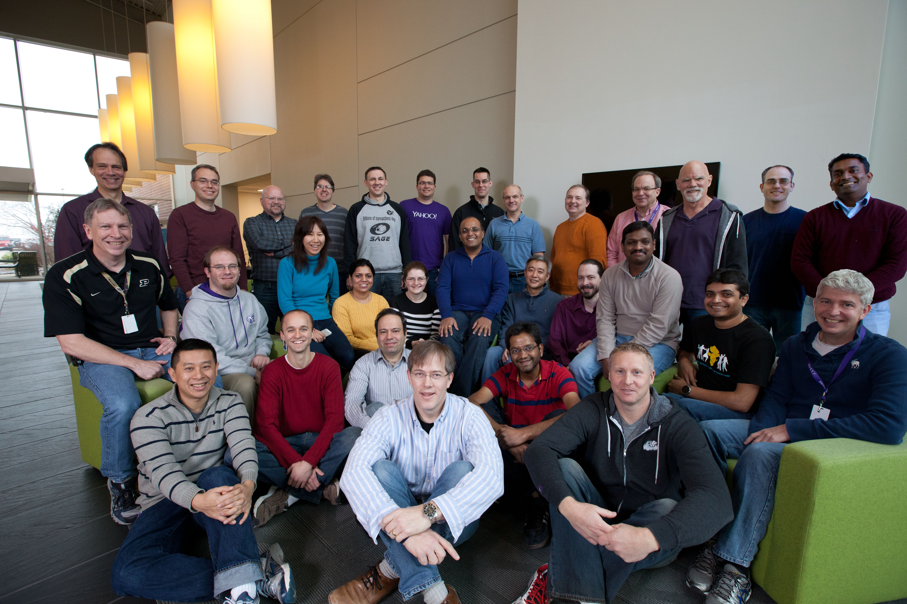
Hi I’m Bobby Evans (bobby@apache.org)
Low Latency Data Processing Architect @ Yahoo
Apache Storm
Apache Spark (mostly batch)
Committer and PMC member for
Apache Storm
Apache Hadoop
Apache Spark
Apache TEZ

Slide 3
Agenda
Part 1: An introduction to Apache Storm (2 hours)
Why Stream Processing is Important
Apache Storm's Architecture
Trident
Micro Batch Processing on Storm
DRPC
Hands On Examples
Part 2: Modifying Apache Storm (1 hour)
Layout of source code
Walk through of adding a new feature to Storm

Slide 4
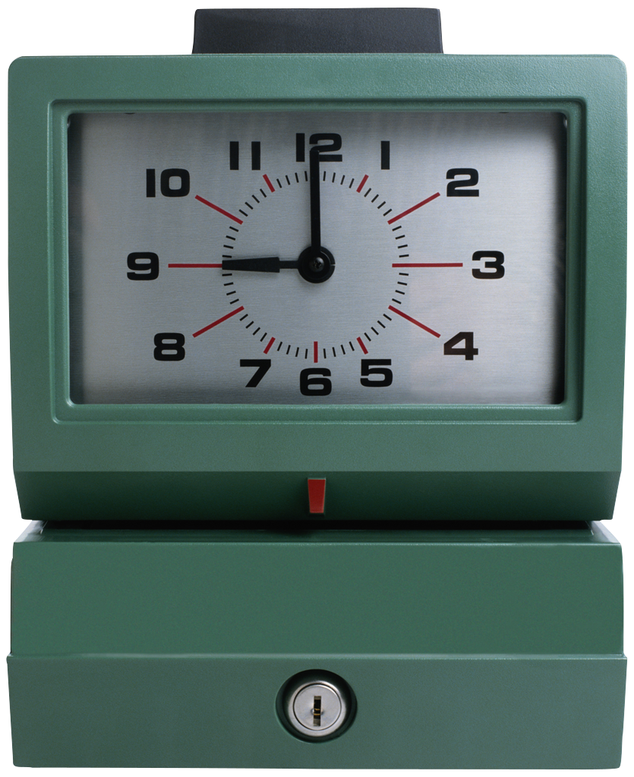

Why is Stream Processing Important?
=

Slide 5

Why is Stream Processing Important?
Questions Asked per Hour
How fast can I query lots of data
Reaction Time
How quickly can I respond to the incoming data
background: https://www.flickr.com/photos/68942208@N02/16242761551

Slide 6
Lambda Architecture
http://nathanmarz.com/blog/how-to-beat-the-cap-theorem.html
Fast real-time path with batch backup
Async
Batch
Batch
Batch
Batch
Batch
Batch
Input
Source of Truth
Deltas
Real-time Streaming

Slide 7
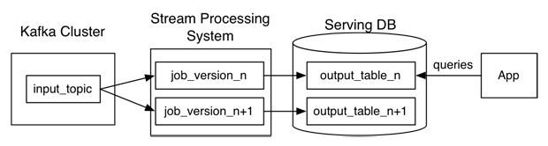
Kappa Architecture
http://radar.oreilly.com/2014/07/questioning-the-lambda-architecture.html
Why write it twice?

Slide 8
Apache Storm

Slide 9
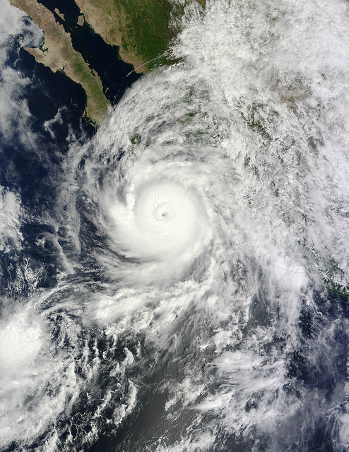
Apache Storm
Guaranteed data processing
Horizontal scalability
Fault-tolerance
No intermediate message brokers
Higher level abstraction than message passing
“Just works”
Hadoop of real time streaming jobs
Built by Backtype, bought by Twitter
Opensourced and a part of Apache now
background: https://www.flickr.com/photos/gsfc/15072362777

Slide 10
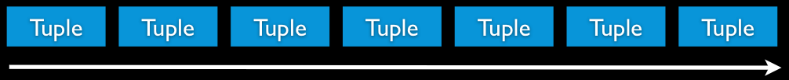
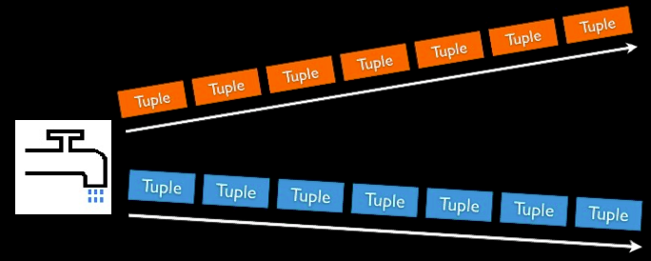
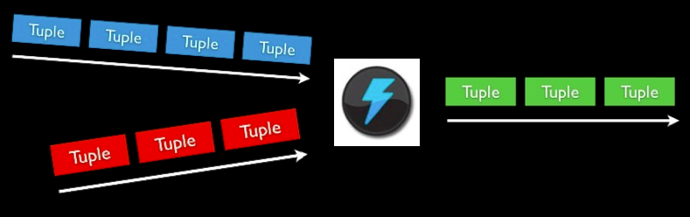
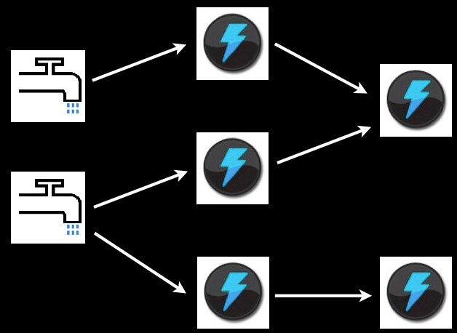
Storm Concepts
Streams
Unbounded sequence of tuples
Spout
Source of Stream
E.g. Read from Twitter streaming API
Bolts
Processes input streams and produces new streams
E.g. Functions, Filters, Aggregation, Joins
Topologies
Network of spouts and bolts

Slide 11
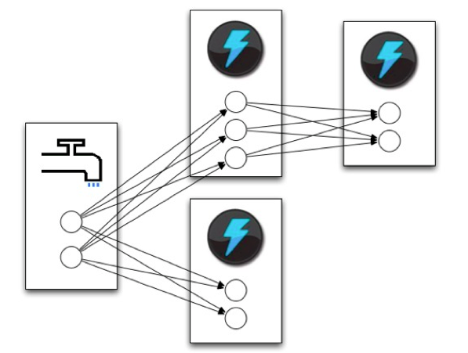
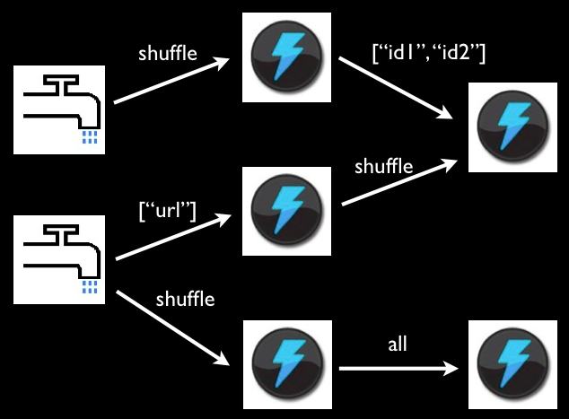
Routing of tuples
Shuffle grouping: pick a random task (but with load balancing)
Fields grouping: consistent hashing on a subset of tuple fields
All grouping: send to all tasks
Global grouping: pick task with lowest id
Shuffle or Local grouping: If there is a local bolt (in the same worker process) use it otherwise use shuffle
Partial Key grouping: Fields grouping but with 2 choices for load balancing.

Slide 12
Storm Architecture
Worker
Supervisor
Worker
Zookeeper
Supervisor
Nimbus
Zookeeper
Supervisor
Worker
Zookeeper
Supervisor
Worker
Master Node
Cluster Coordination
Launches workers
Worker processes

Slide 13
Worker
Task
(Spout A-1)
Task
(Spout A-5)
Task
(Spout A-9)
Routing
Task
(Bolt B-3)
Other Workers
Task
(Acker)

Slide 14
Example: WordCount in Storm
TopologyBuilder builder = new TopologyBiulder();
builder.setSpout(“spout”, new KestrelSpout(“kestrel.twitter.com”,
22133, “sentence_queue”, new StringScheme()),5);
builder.setBolt(“split”, new SplitSentence(), 8).shuffleGrouping(“spout”);
builder.setBolt(“count”, new WordCount(), 12)
.fieldGrouping(“split”, new Fields(“word”));
//===============================================================
public static class SplitSentence extends ShellBolt implements IRichBolt {
//Code to split a sentence
}
public static class WordCount implements IBasicBolt{
//Code to count words, have to override the execute function
public void execute(Tuple tuple, BasicOutputCollector collector){
//…
}
}
//================================================================
StormSubmitter.submitTopology(“word-count”, builder.createTopology());
Parallelism Degree
(Number of tasks for a spout or Bolt)

Slide 15

Guaranteeing Message Processing In Three Tasty Flavors
None (like S4)
At Least Once
Exactly Once (like Hadoop)
background: https://www.flickr.com/photos/maf04/14392794749

Slide 16
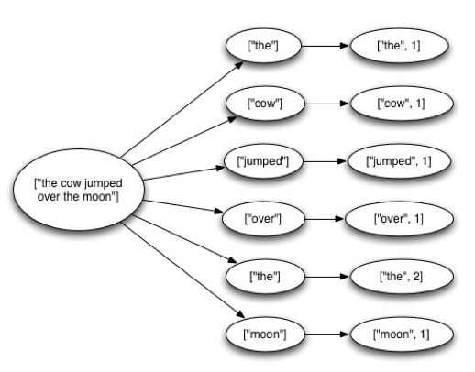
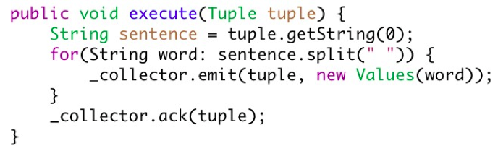
At Least Once
Tuple Tree
A spout tuple is not fully processed until all tuples in the tree have been completed
If the tuple tree is not completed within a specified timeout, the spout tuple is replayed
Uses acker tasks to keep track of tuple progress
Reliability API for the user:
“Anchoring” creates a new edge in the tuple tree
Marks a single node in the tree as complete

Slide 17
At Least Once
What happens if there is a failure?
You can double process events.
This is not so critical if you have something like Hadoop to back you up and correct the issue later.
Or if you are looking at statistical trends and replay does not happen that often.
This requires you to have a spout that supports replay. Not all messaging infrastructure does.

Slide 18
At Least Once
SPOUT
SPLIT
COUNT
[“the”]
[“the”, 2]
[“cow”]
[“cow”, 1]
[“the cow jumped over the moon”]
[“jumped”]
[“jumped”, 1]
[“over”]
[“over”, 1]
[“the”]
[“moon”]
[“moon”, 1]
Acker

Slide 19
At Least Once
SPOUT
SPLIT
COUNT
[“the”]
[“the”, 2]
[“the”, 4]
[“cow”]
[“cow”, 1]
[“cow”, 2]
[“the cow jumped over the moon”]
[“jumped”]
[“jumped”, 1]
[“over”, 1]
[“over”]
[“over”, 2]
[“the”]
[“moon”]
[“moon”, 1]
[“moon”, 2]
Acker

Slide 20

Exactly Once - Transactional Topologies (Deprecated)
Transactional Topologies provide a strong ordering of processing.
A small batch of tuples are processed at a time.
Each batch completely succeeds or completely fails.
Each batch is “committed” in order.
Partial processing is pipelined
Requires the spout to be able to replay a batch.
background: https://www.flickr.com/photos/oregondot/15799498927

Slide 21
Transactional Topologies (Tuple Count)
MemoryTransactionalSpout spout =
new MemoryTransactionalSpout(DATA, new Fields("word"),
PARTITION_TAKE_PER_BATCH);
TransactionalTopologyBuilder builder =
new TransactionalTopologyBuilder("global-count", "spout", spout, 3);
builder.setBolt("partial-count", new BatchCount(), 5)
.shuffleGrouping("spout");
builder.setBolt("sum", new UpdateGlobalCount())
.globalGrouping("partial-count");
Transactional Spout
Partial Count
Global Count

Slide 22
Transactional Topologies (Word Count)
Batch 1
[“a”],[“b”],[“c”]
Transactional Spout
Partial Count
Global Count
DB
[0, 100]

Slide 23
Transactional Topologies (Word Count)
Batch 2
[“d”],[”e”]
Batch 1
[3]
Transactional Spout
Partial Count
Global Count
DB
[0, 100]

Slide 24
Transactional Topologies (Word Count)
Batch 3
[“f”],[”g”]
Batch 2
[2]
Batch 1
[3 + 100]
Transactional Spout
Partial Count
Global Count
DB
[1, 103]

Slide 25
Trident

Slide 26

But What About State
For most of storm state storage is left up to you.
If your bolt goes down with 3 weeks of aggregated data that you have not stored any where, well too bad.
background: https://www.flickr.com/photos/68397968@N07/14600216228

Slide 27

Enter Trident
Provides exactly once semantics like transactional topologies.
In trident state is a first class citizen, but the exact implementation of state is up to you.
There are many prebuilt connectors to various NoSQL stores like HBase
Provides a high level API (similar to cascading for Hadoop)
background: https://www.flickr.com/photos/gedas/3618792161

Slide 28
Trident Example
TridentTopology topology =
new TridentTopology();
TridentState wordCounts =
topology.newStream("spout1", spout)
.each(new Fields("sentence"), new Split(), new Fields("word"))
.groupBy(new Fields("word"))
.persistentAggregate(new MemoryMapState.Factory(), new Count(), new Fields("count"))
.parallelismHint(6);
Aggregates values and stores them.

Slide 29
Trident Example
public class Split extends BaseFunction {
public void execute(TridentTuple tuple, TridentCollector collector) {
String sentence = tuple.getString(0);
for(String word: sentence.split(" ")) {
collector.emit(new Values(word));
}
}
}
No Acking Required

Slide 30
DRPC

Slide 31

DRPC
Distributed Remote Procedure Call
Turns a RPC call into a tuple sent from a spout
Takes a result from that and sends it back to the user.
background: http://bit.ly/1KypnCN

Slide 32
DRPC Example from Trident
Client:
DRPCClient client = new DRPCClient("drpc.server.location", 3772);
System.out.println(client.execute("words", "cat dog the man");
// prints the JSON-encoded result, e.g.: "[[5078]]"
Same word count topology
StormState from word count topology
Topology:
topology.newDRPCStream("words")
.each(new Fields("args"), new Split(), new Fields("word"))
.groupBy(new Fields("word"))
.stateQuery(wordCounts, new Fields("word"), new MapGet(), new Fields("count"))
.each(new Fields("count"), new FilterNull())
.aggregate(new Fields("count"), new Sum(), new Fields("sum"));

Slide 33

Questions?

Slide 34
Hands on Example (more word count)

Slide 35
Setup your environment
Need Git, java, maven, and python
$ git clone https://github.com/revans2/storm-tutorial.git
$ cd storm-tutorial
$ mvn clean package
apache-storm-0.10.0-SNAPSHOT directory is a recent storm build

Slide 36

Run wordcount in local mode
$ ./apache-storm-0.10.0-SNAPSHOT/bin/storm jar ./target/storm-examples-0.0.1-jar-with-dependencies.jar com.yahoo.wc.TWC1
…
background: https://www.flickr.com/photos/brbirke/8136032514

Slide 37

Now lets change it...
Start with src/main/java/com/yahoo/wc/WC3.java
Output top word over a given second with a 2 second lookback.
background: https://www.flickr.com/photos/12567713@N00/2859921414

Slide 38
Temperature Controller
$ ./apache-storm-0.10.0-SNAPSHOT/bin/storm jar ./target/storm-examples-0.0.1-jar-with-dependencies.jar com.yahoo.temp.BangBang
How about only turn up the temp when the user is close by (not done yet).
src/main/java/com/yahoo/temp/BangBangLocation.java
What other smarts would you want to add?

Slide 39
Other examples to look at
Streaming top N words for twitter
https://git.corp.yahoo.com/rfarivar/twitter-storm-wordcloud-demo
Many examples including:
RollingTopWords, SingleJoin, Twitter Reach
https://github.com/apache/storm/tree/master/examples/storm-starter
Several Examples using kafak:
http://hortonworks.com/hadoop/storm/

Slide 40
Modifying Apache Storm

Slide 41
Source Layout
$ git clone https://github.com/apache/storm.git
bin/ - scripts
conf/ - default configs
docs/ - documentation and site
storm-core/ - storm source
example/ - storm starter
external/ - integration with kafka, redis, hadoop, …

Slide 42
Source Layout storm-core/
src/jvm/ - java
src/clj/ - clojure (don’t be scared)
Packages/Namespaces:
storm.trident – trident
backtype.storm – base storm
Most of the interesting code is in
storm-core/src/clj/backtype/storm/daemon/
{nimbus.clj supervisor.clj worker.clj task.clj}
https://github.com/apache/storm/tree/master/storm-core/src/clj/backtype/storm/daemon

Slide 43
Extension points
Scheduling:
https://github.com/apache/storm/blob/master/storm-core/src/jvm/backtype/storm/scheduler/IScheduler.java
Set by the config storm.scheduler
Messaging:
https://github.com/apache/storm/blob/master/storm-core/src/jvm/backtype/storm/messaging/IContext.java
Set by the config storm.messaging.transport
Authentication/Authorization:
Too many to list here…

Slide 44
Questions?

Slide 45
Backup Slides

Slide 46
Partial Key Grouping
https://melmeric.files.wordpress.com/2014/11/the-power-of-both-choices-practical-load-balancing-for-distributed-stream-processing-engines.pdf
Initial Code:
https://issues.apache.org/jira/browse/STORM-632
https://github.com/apache/storm/pull/395
Integration:
https://issues.apache.org/jira/browse/STORM-637
https://github.com/apache/storm/pull/404

Slide 47
REST DRPC
Client:
curl http://drpc.server.location:3773/drpc/words/cat%20dog%20the%20man
//Prints the JSON encoded result, just like normal DRPC

Slide 48
Security

Slide 49
Authentication By Type
HTTP – Using HTTP Authentication or with a Custom Java Servlet Filter.
Thrift – Kerberos (Possibly through a forwarded TGT)
ZooKeeper – Kerberos for system processes (Because there is a keytab available) a shared secret for worker processes with MD5SUM in ZK.
File System – OS user + FS permissions. Some processes on the same system communicate through files.
Worker to Worker – Can use encryption with shared secret, but we really need to add in SASL Auth.
External Services (like HBase) – Sorry it is up to you (Sort of …)

Slide 50
Credentials Push (Authenticating with External Services)
A set of APIs and plugins that allow credentials to securely be delivered and renewed.
ICredentialsListener – when bolt or spout implements this they are informed of credentials updates.
IAutoCredentials – Provides a way to automatically include credentials and to populate them into a Subject on the worker side.
ICredentialsRenewer – Some credentials need to be renewed periodically. This allows Nimbus to do that for a topology.
storm upload_credentials – command line that allows the user to push updated credentials to a topology (API through storm submitter available too).
AutoTGT – Implementation of IAutoCredentials and ICredentialsRenewer that allows a forwardable TGT to be used by the topology. (Also some ugliness to make it work with Hadoop/HBase)

Slide 51
Authorization
A plugin API has also been added to block unwanted operations, along with some reasonable implementations.
For Example SimpleACLAuthorizer for Nimbus.
Can configure Administrators that can do anything.
Users that the supervisors are running as.
Topology can also configure who is allowed to kill or rebalance it.
DRPC Authorization is still being worked on, but should be done soon.

Slide 52
Multi-tenancy supervisor.run.worker.as.user: true
Borrowed and modified some code from Hadoop to let Supervisor launch workers as the user that ran the topology.

Slide 53
What’s Next
(Research Project Ideas!!!!)

Slide 54
Scheduling (Especially on Large Clusters)
Currently round robin (We should be able to do better)
Take into account resource utilization (Network)
Locality with collocated services (Is there any advantage to running storm on the same nodes as HBase and/or Kafka?)
What about with storm on yarn?
When is it worth it to kill a worker because a better location is available? (automatic rebalance)
Slow node detection (12 ms)

Slide 55
Cleanly integrating intermediate message brokers/Data discovery.
We don’t want messages to be persisted in between all processing, but for very large systems can we separate them out.

Slide 56
How can I grow/shrink a topology dynamically
How to handle the different shuffles? Do I kill everything and start over or is there a better way?
When should I grow or shrink?
What do I do if there are no free resources and I need to grow?
Or even more difficult can I upgrade a topology in place without killing processes?

Slide 57
Resource Isolation/Utilization
Isolation is handled currently by creating a mini-cluster (whole nodes) for a single topology (so utilization suffers).
Can we get better utilization without letting isolation suffer? cgroups/Docker. What about predictability on heavily used vs. lightly used clusters? (12ms again)
What about if I collocate this batch on Hadoop?

Slide 58
Higher level APIs
Streaming SQL (Spark streaming has it why shouldn’t we?!)
Pig on storm (This is happening)

Slide 59
What is being built with storm
(Even More Research Project Ideas!!!!)

Slide 60
Summing Bird
https://github.com/twitter/summingbird
Run the same code on Storm and Hadoop.

Slide 61
Statistical Analytics Systems
Sketches: Imagine compressing several terabytes of data into a few MB, and being able to do complex computational processing on them with a known maximum error.
http://highlyscalable.wordpress.com/2012/05/01/probabilistic-structures-web-analytics-data-mining/
Oddly searching for sketches tends to show pencil drawings and nothing about statistics. Try adding in statistics or mathematics when you search.

Slide 62
Online Machine Learning
Update a ML model in near real time, and score results using it at the same time.
http://www.bigdata-cookbook.com/post/50334182923/machine-learning-over-storm

Slide 63
Metrics/Monitoring

Slide 64
Register Metrics
transient CountMetric _countMetric;
transient ReducedMetric _wordLengthMeanMetric;
@Override
public void prepare(Map conf, TopologyContext context, OutputCollector collector) {
_collector = collector;
_countMetric = new CountMetric();
_wordLengthMeanMetric = new ReducedMetric(new MeanReducer());
context.registerMetric("execute_count", _countMetric, 5);
context.registerMetric("word_length", _wordLengthMeanMetric, 60);
}
How often to collect the metrics

Slide 65
Update the Metrics When Something Happens
Register a Metrics Consumer Before Launching Topology
conf.registerMetricsConsumer(LoggingMetricsConsumer.class, 2);
@Override
public void execute(Tuple tuple) {
String word = tuple.getString(0);
_collector.emit(tuple, new Values(word + "!!!"));
_collector.ack(tuple);
_countMetric.incr();
_wordLengthMeanMetric.update(word.length());
}

